Slide 1
CSE215: Database Dr. Abu Sayed Md. Latiful Hoque Professor Dept. of CSE, BUET Contact: 01556346357 asmlatifulhoque@cse.buet.ac.bd

Slide 2
Course Methodology
Each lecture will have some questions to answer
You have to sit in the lecture with white paper and black ball point pen
You have to write the answer to the paper
Every Monday after class, you will have to upload the pdf of the answer of the questions.
These submissions will carry 50% marks of class attendance the remaining 50% will be taken from zoom attendance.
There will be 2 quizzes and 1 assignment

Slide 3
Content
Storage
Indexing
Query processing
Transaction
Concurrency Control
Recovery
Parallel and Distributed Database Overview

Slide 4
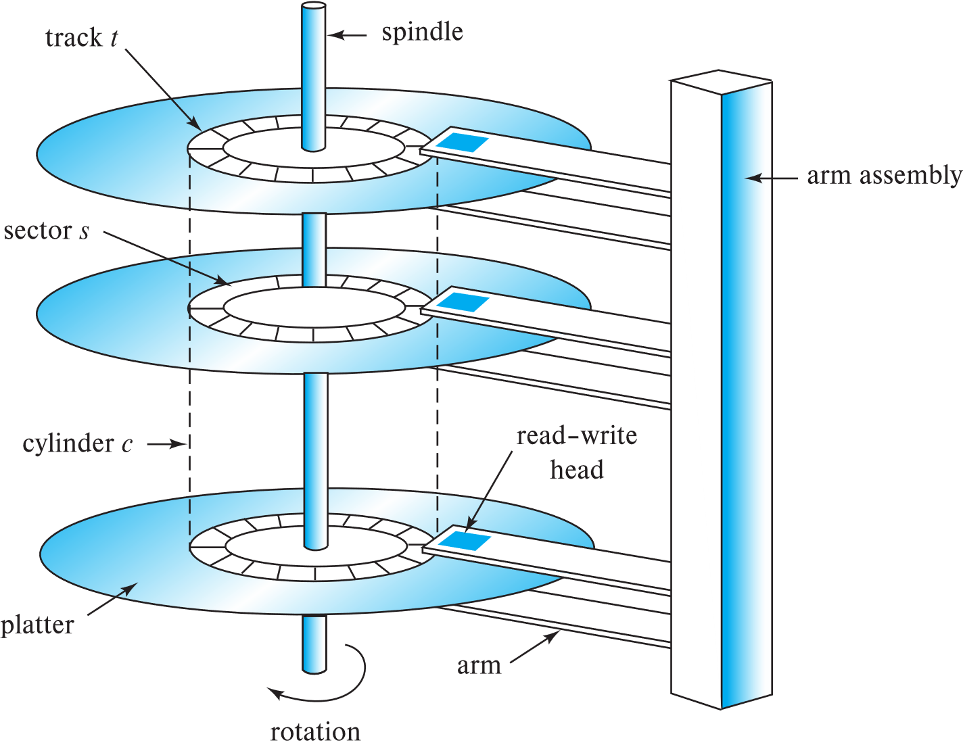
Performance Measures of Disks
Access time – the time it takes from when a read or write request is issued to when data transfer begins.
= Seek time + Rotational Latency
Seek time – time it takes to reposition the arm over the correct track.
Average seek time is 1/2 the worst case seek time.
4 to 10 milliseconds on typical disks
Rotational latency – time it takes for the sector to be accessed to appear under the head.
4 to 11 milliseconds on typical disks (5400 to 15000 r.p.m.)
Average latency is 1/2 of the above latency.
Overall latency is 5 to 20 msec depending on disk model
Schematic diagram of magnetic disk drive

Slide 5
Performance Measures of Disks
Disk block is a logical unit for storage allocation and retrieval
4 to 16 kilobytes typically
Smaller blocks: more transfers from disk
Larger blocks: more space wasted due to partially filled blocks
Sequential access pattern
Successive requests are for successive disk blocks
Disk seek required only for first block
Schematic diagram of magnetic disk drive

Slide 6
Performance Measures of Disks
Random access pattern
Successive requests are for blocks that can be anywhere on disk
Each access requires a seek
Transfer rates are low since a lot of time is wasted in seeks
I/O operations per second (IOPS)
Number of random block reads that a disk can support per second
50 to 200 IOPS on current generation magnetic disks
Schematic diagram of magnetic disk drive

Slide 7
Performance Measures of Disks
Given disk storage size as follows:
Track number range | Size (GB)
1 - 20000 | 20.48
20001 – 40000 | 10.24
The relations and the corresponding size are given below. The relations are stored consecutively in the disk platter starting from track number 1 and platter number 1.
Relation name | Size (GB)
customer | 10.24
product | 10.24
sale | 10.24
Question 2-1
Explain why block is used in DBMS instead of segment to READ/WRITE to disk?
Find the starting track number of relations customer, product and sale respectively.
Explain the disk head movement and the number of seek to process the above three queries. The initial head position was in track 1.
The following queries Q1 – Q3 are executed consecutively.
Query | SQL
Q1 | SELECT * FROM SALE
Q2 | SELECT * FROM CUSTOMER
Q3 | SELECT * FROM PRODUCT

Slide 8
RAID
RAID: Redundant Arrays of Independent Disks
disk organization techniques that manage a large numbers of disks, providing a view of a single disk of
high capacity and high speed by using multiple disks in parallel,
high reliability by storing data redundantly, so that data can be recovered even if a disk fails

Slide 9
Improvement in Performance via Parallelism
Two main goals of parallelism in a disk system:
Load balance multiple small accesses to increase throughput
Parallelize large accesses to reduce response time.
Improve transfer rate by striping data across multiple disks.
Bit-level striping – split the bits of each byte across multiple disks. In an array of eight disks, write bit i of each byte to disk i.
Each access can read data at eight times the rate of a single disk (sequential access).
Example: select * from student;
But seek/access time worse than for a single disk. (Find i^{th} Byte?)
Example: Select * from student where id = 05050
Bit level striping is not used much any more
Student relation
101011110000000011111111…
Storing 1st byte
1
0
1
0
1
1
1
1
Storing 2nd byte
10
00
10
00
10
10
10
10

Slide 10
Improvement in Performance via Parallelism
Student relation
B0, B1, B2, B3, B4, B5, B6, B7, B8, B9, B10, B11, B12, B13
Block-level striping – with n disks, block i of a file goes to disk (i mod n) + 1
1. Requests for different blocks can run in parallel if the blocks reside on different disks
Example: Example: Select * from student where id >= 05005
2. A request for a long sequence of blocks can utilize all disks in parallel
Example: select * from student;
Block-level striping with 8 disks
B0
B1
B0
B3
B4
B5
B6
B7
After Block 7
B0
B8
B1
B9
B2
B10
B3
B11
B4
B12
B5
B13
B6
B7
Question 3-1: Explain points 1 and 2 of block level striping

Slide 11
RAID Levels
RAID Level 0
Example: You need 8TB of storage and there are available of 2TB disks.
How many disks will be needed for this storage system in RAID 0?
Different RAID organizations, or RAID levels, have differing cost, performance and reliability characteristics
RAID Level 0: Block striping; non-redundant.
Used in high-performance applications where data loss is not critical.
D0 D1 D2 D3
You have to store student relation file (B0, B1, B2, B3, B4, B6, B7, B8, B9) into the storage system of RAID 0.
How?
D0 D1 D2 D3
B0
B4
B8
B1
B5
B9
B2
B6
B3
B7

Slide 12
RAID Levels
RAID Level 1 (Mirroring)
RAID Level 1: Mirrored disks with block striping
Offers best write performance.
Popular for applications such as storing log files in a database system.
Example: You need 8TB of storage and there are available of 2TB disks.
How many disks will be needed for this storage system in RAID 1?
D0 D1 D2 D3
D4 D5 D6 D7
DATA
MIRROR DISK
Question 2-2: You have been given 6 disks of 4TB each and customer relation has 6 blocks (B0, B1, B2, B3, B4, B5).
Show the storage of customer relation using
RAID level 0 storage system
RAID level 1 storage system
Compare performance of the two system.
You have to store student relation file (B0, B1, B2, B3, B4, B5, B6, B7, B8, B9) into the storage system of RAID 1.
How?
D0 D1 D2 D3
B0
B4
B8
B1
B5
B9
B2
B6
B3
B7
D4 D5 D6 D7
B0
B4
B8
B1
B5
B9
B2
B6
B3
B7

Slide 13
RAID Levels (Cont.)
RAID Level 5 (Block striping distributed parity)
Example: You need 8TB of storage and there are available of 2TB disks.
How many disks will be needed for this storage system in RAID 5?
RAID Level 5: Block-Interleaved Distributed Parity;
partitions data and parity among all N + 1 disks, rather than storing data in N disks and parity in 1 disk (like RAID 4).
E.g., with 5 disks, parity block Pk for blocks 4k, 4k+1, 4k+2, 4k+3 is stored in disk k mod 5.
P0
B4
B8
D0 D1 D2 D3 D4
B0
P1
B9
B1
B5
B2
B6
B3
B7
Example: You have been given six disks of 2TB each.
What are the effective storage capacity in RAID 0, RAID 1, RAID 5?
RAID 0 = 12TB, RAID 1 = 6TB,
RAID 5 = 10TB

Slide 14
RAID Levels (Cont.)
RAID Level 5 (Block striping distributed parity)
Parity blocks: Parity block j stores XOR of bits from block j of each disk
How is recovery performed single disk failure?
To recover data for a block, compute XOR of bits from all other blocks in the set including the parity block
What will happen if two disks failed simultaneously?
Example: You need 8TB of storage and there are available of 2TB disks.
How many disks will be needed for this storage system in RAID 5?
P0
B4
B8
D0 D1 D2 D3 D4
B0
P1
B9
B1
B5
B2
B6
B3
B7

Slide 15
RAID Levels (Cont.)
RAID Level 5 (Block striping distributed parity)
How is update of one block performed in RAID 5?
Example: Updating block B2 of D2, parity block P0 must also be computed and written to disk
Can be done by using old parity block, old value of current block (B2) and new value of current block (B2) (2 block reads + 2 block writes)
Or by recomputing the parity value using the new values of blocks corresponding to the parity block. More efficient for writing large amounts of data sequentially
Example: You need 8TB of storage and there are available of 2TB disks.
How many disks will be needed for this storage system in RAID 5?
P0
B4
B8
D0 D1 D2 D3 D4
B0
P1
B9
B1
B5
B2
B6
B3
B7

Slide 16
RAID Levels (Cont.)
RAID Level 6: P+Q Redundancy scheme; similar to Level 5, but stores two error correction blocks (P, Q) instead of single parity block to guard against multiple disk failures.
Better reliability than Level 5 at a higher cost
Becoming more important as storage sizes increase
Uses error correcting REED-Solomon code
P0
B4
B8
Q0
P1
B9
B0
Q1
B1
B5
B2
B6
B3
B7
D0 D1 D2 D3 D4 D5
Distribution of error correcting block and data blocks
with 6 disks, two error correcting blocks Pk and Qk for data blocks for blocks 4k, 4k+1, 4k+2, 4k+3 is stored in disk k mod 6 and (k+1) mod 6.
Question 4-1: Compare RAID 5 and RAID 6 in terms of cost, update, recovery and reliability.

Slide 17
Choice of RAID Level
Factors in choosing RAID level
Monetary cost
Performance: Number of I/O operations per second, and bandwidth during normal operation
Performance during failure
Performance during rebuild of failed disk
Including time taken to rebuild failed disk
RAID 0 is used only when data safety is not important
E.g., data can be recovered quickly from other sources

Slide 18
Choice of RAID Level (Cont.)
Level 1 provides much better write performance than level 5
Level 5 requires at least 2 block reads and 2 block writes to write a single block, whereas Level 1 only requires 2 block writes
Level 1 had higher storage cost than level 5
Level 5 is preferred for applications where writes are sequential and large (many blocks), and need large amounts of data storage
RAID 1 is preferred for applications with many random/small updates
Level 6 gives better data protection than RAID 5 since it can tolerate two disk (or disk block) failures
Increasing in importance since latent block failures on one disk, coupled with a failure of another disk can result in data loss with RAID 1 and RAID 5.

